Slide 1
LECTURE SLIDE - 6
Chapter 6: Parallel dc Circuits
*
1

Slide 2
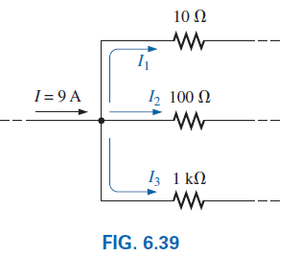
6.6 Current Divider Rule (CDR)
For series circuits we have the powerful voltage divider rule (VDR) for finding the voltage across a resistor in a series circuit.
We now introduce the equally powerful current divider rule (CDR) for finding the current through a resistor in a parallel circuit.
*
2

Slide 3
6.6 Current Divider Rule
We already know current will always seek the path of least resistance.
For two parallel elements of equal value, the current will divide equally.
For parallel elements with different values, the smaller the resistance, the greater the share of input current.
For parallel elements of different values, the current will split with a ratio equal to the inverse of their resistor values.
Example 6.21
*
3

Slide 4
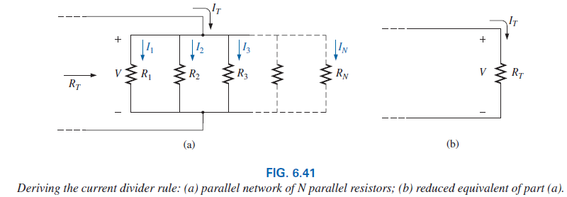

6.6 Current Divider Rule
The current divider rule is particularly important if only the total entering current and resistances are known.
*
4

Slide 5
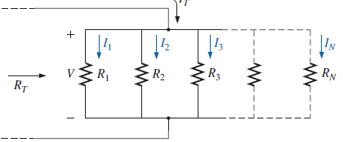
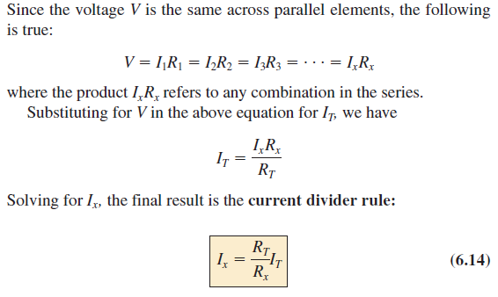
*
5

Slide 6
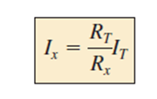
6.6 Current Divider Rule
which states that the current through any branch of a parallel resistive network is equal to the total resistance of the parallel network divided by the resistor of interest and multiplied by the total current entering the parallel configuration.
Since R_{T} and I_{T} are constants, for a particular configuration the larger the value of R_{x} (in the denominator), the smaller the value of I_{x} for that branch, confirming the fact that current always seeks the path of least resistance.
Example 6.22
Also note that, for a parallel network, the current through the smallest resistor will be very close to the total entering current if the other parallel resistors of the configuration are much larger in magnitude.
*
6

Slide 7
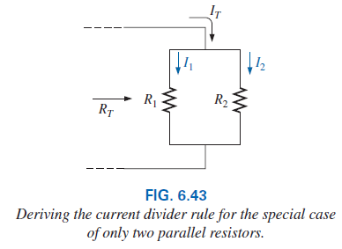
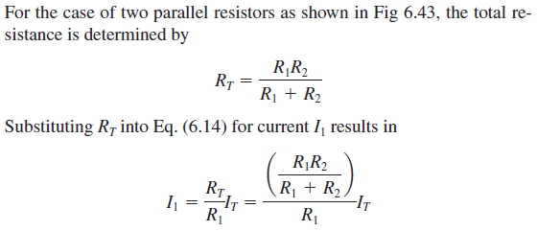


6.6 CDR: Special Case: Two Parallel Resistors
For two parallel resistors, the current through one is equal to the other resistor times the total entering current divided by the sum of the two resistors.
*
7

Slide 8
6.6 CDR: Special Case: Two Parallel Resistors
Take particular note, however, that the denominator of the equation is simply the sum, not the total resistance, of the combination.
Example 6.23
*
8

Slide 9
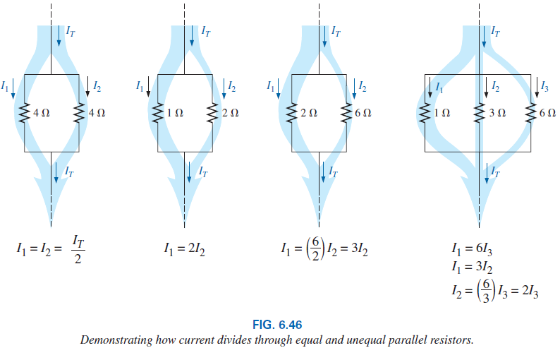
6.6 CDR: Summary
In summary, remember that current always seeks the path of least resistance, and the ratio of the resistor values is the inverse of the resulting current levels, as shown in Fig 6.46 and the thickness of the blue bands reflects the relative magnitude of the current in each branch.
*
9

Slide 10
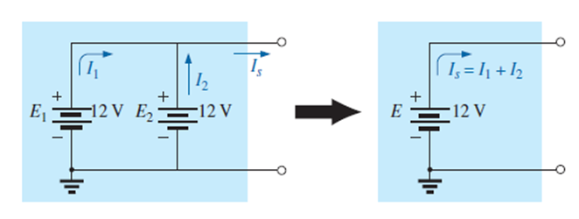

6.7 Voltage Sources in Parallel
Because the voltage is the same across parallel elements, voltage sources can be placed in parallel only if they have the same voltage.
The primary reason for placing two or more batteries or supplies in parallel is to increase the current rating above that of a single supply.
For example, in Fig 6.47, two ideal batteries of 12 V have been placed in parallel. The total source current using Kirchhoff’s current law is now the sum of the rated currents of each supply.
The resulting power available will be twice that of a single supply if the rated supply current of each is the same. That is,
*
10

Slide 11
6.7 Voltage Sources in Parallel
If for some reason two batteries of different voltages are placed in parallel, both will become ineffective or damaged because the battery with the larger voltage rapidly discharges through the battery with the smaller terminal voltage.
It makes no sense to talk about placing an ideal 12 V battery in parallel with a 6 V battery, because Kirchhoff’s voltage law would be violated.
*
11

Slide 12
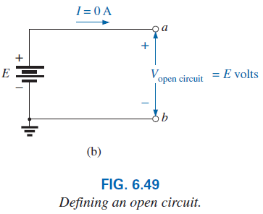
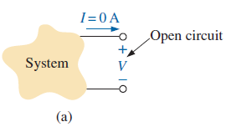
6.8 Open and Short Circuits
An open circuit is two isolated terminals not connected by an element of any kind, as shown in Fig. 6.49(a).
Since a path for conduction does not exist, the current associated with an open circuit must always be zero.
An open circuit can have a potential difference (voltage) across its terminals, but the current is always zero amperes.
In Fig. 6.49(b), an open circuit exists between terminals a and b. The voltage across the open-circuit terminals is the supply voltage, but the current is zero due to the absence of a complete circuit.
*
12

Slide 13
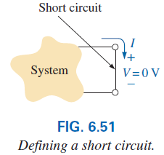
6.8 Short Circuit
A short circuit is a very low resistance, direct connection between two terminals of a network, as shown in Fig. 6.51.
The current through the short circuit can be any value, as determined by the system it is connected to, but the voltage across the short circuit is always zero volts because the resistance of the short circuit is assumed to be essentially zero ohms and V = IR = I(0 ) Ω = 0 V.
In summary, a short circuit can carry a current of a level determined by the external circuit, but the potential difference (voltage) across its terminals is always zero volts.
*
13

Slide 14
6.8 Open and Short Circuit
The terminology short circuit or open circuit is usually associated with dire situations such as power loss, smoke, or fire.
However, in network analysis, both can play an integral role in determining specific parameters about a system.
Most often, however, if a short-circuit condition is to be established, it is accomplished with a jumper—a lead of negligible resistance to be connected between the points of interest.
Establishing an open circuit just requires making sure that the terminals of interest are isolated from each other.
Examples: 6.25, 6.26, 6.27, 6.28
*
14

Slide 15
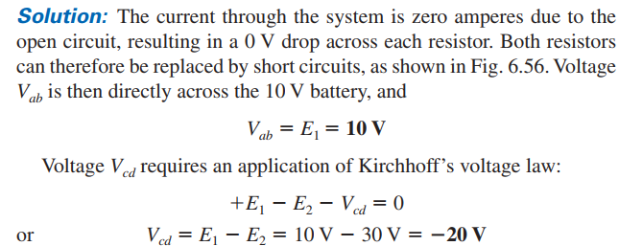
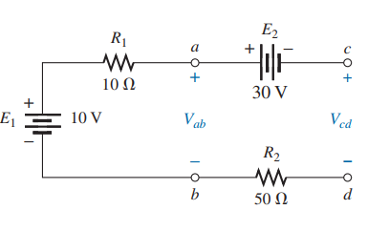
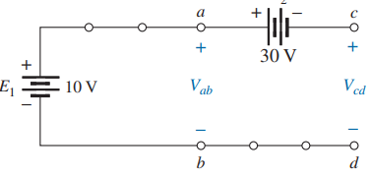
*
15

Slide 16
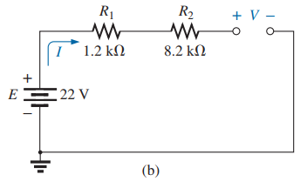
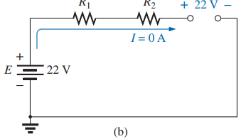
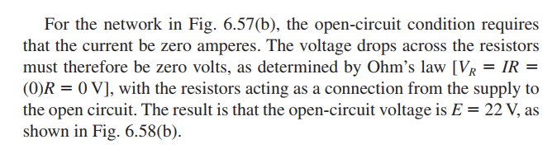
*
16

Slide 17
6.9 Voltmeter Loading Effects
Self study
*
17

Slide 18
6.10 Duality Principle
The equations for the series and parallel configurations have a number of similarities. In fact, the equations for one can often be obtained directly from the other by simply applying the duality principle.
Duality between equations means that the format for an equation can be applied to two different situations by just changing the variable of interest.
For instance, the equation for the total resistance of a series circuit is the sum of the resistances. By changing the resistance parameters to conductance parameters, you can obtain the equation for the total conductance of a parallel network—an easy way to remember the two equations.
*
18

Slide 19
6.10 Duality Principle
Similarly, by starting with the total conductance equation, you can easily write the total resistance equation for series circuits by replacing the conductance parameters by resistance parameters.
Series and parallel networks share two important dual relationships:
(1) between resistance of series circuits and conductance of parallel circuits and
(2) between the voltage or current of a series circuit and the current or voltage, respectively, of a parallel circuit.
*
19

Slide 20
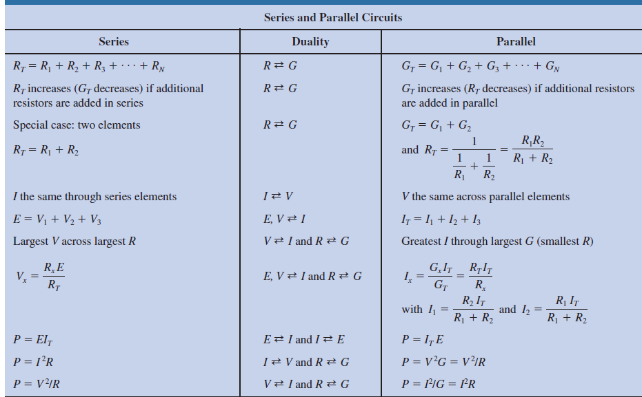
6.10 Summary Table
*
20

Slide 21
6.13 Applications
One of the most important advantages of the parallel configuration is that if one branch of the configuration should fail (open circuit), the remaining branches will still have full operating power.
Another important advantage is that branches can be added at any time without affecting the behavior of those already in place.
Some Common Applications are:
1. Car System
2. House Wiring
3. Parallel Computer Bus Connections
*
21

Slide 22

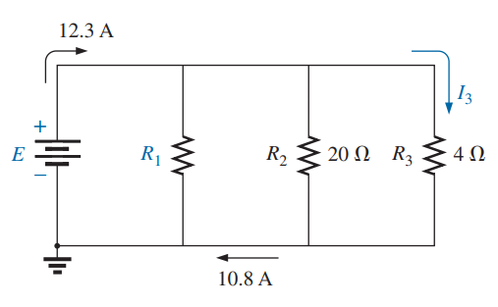


*
22

Slide 23
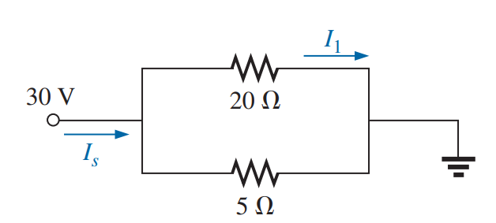

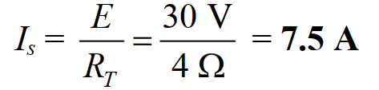
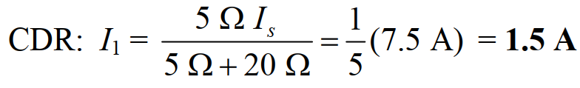
*
23

Slide 24

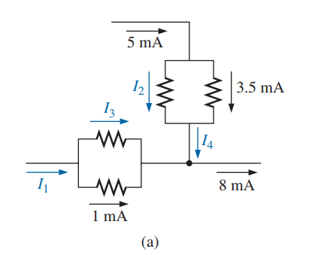


*
24

Slide 25
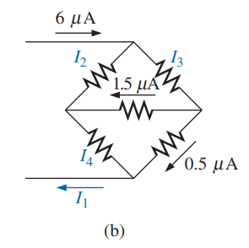



*
25

Slide 26

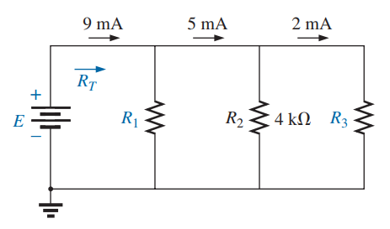




*
26

Slide 27
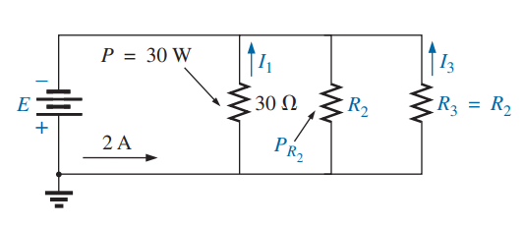
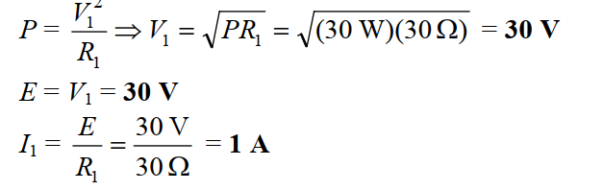
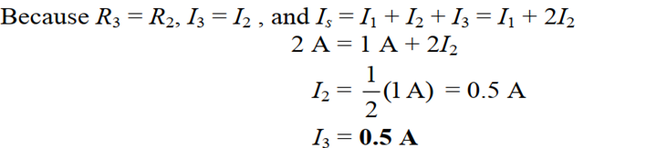
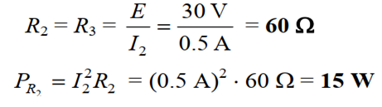
*
27

Slide 28
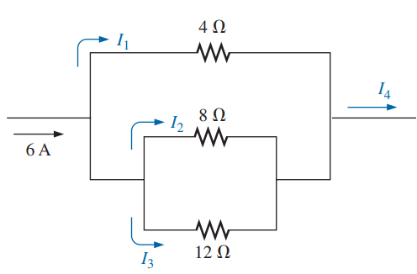
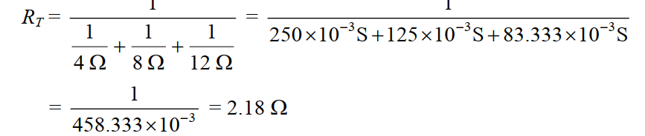
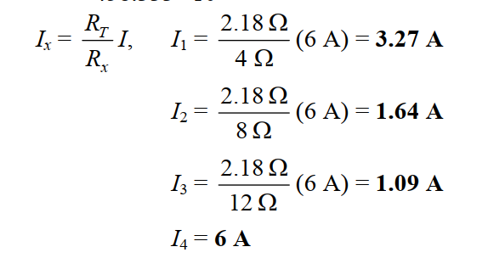
*
28

Slide 29
Thank You
*
29

